Slide 1
Lecture 9
JavaScript

Slide 2
Previous Lecture
Passing parameters in event callbacks
Accessing form elements with IDs
Performed validation on Forms elements
Used preventDefault() to stop the flow of an event

Slide 3
Today’s Lecture
DOM Manipulation
Executing JavaScript

Slide 4
Executing JavaScript
To be able to access any part of your document, we must wait or find an event point so that we can execute JS and access any part of the element.
Example>
window.onload = function(){ //your javascript }

Slide 5
What is DOM?
DOM stands for Document Object Model.
Since our web page is a document. In that sense,
DOM represents the document as nodes and
objects. Using this, programming languages
can connect to the page.

Slide 6
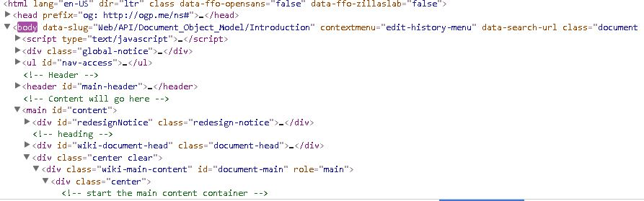
What is DOM?
DOM provides structure for HTML and XML documents. We can call an organization chart for our web pages

Slide 7
DOM Rocks!
Using the DOM API, we can dynamically change the our web documents on runtime.

Slide 8
API?
API stands for Application Programming Interface.
API has a quite wide scope regarding definitions but generally, it is used to refer to a set of routines and tools which different software components can be used to interact with each other. API (HTML or XML page) = DOM + JS (scripting language)

Slide 9
Getting Started With DOM Manipulation
Creating elements on runtime.
var newTag = document.createElement(‘h1’);
newTag.innerHTML = ‘Khurram’;
document.body.appendChild(newTag);
//createElement (Creates a new element)
//appendChild (Inserts an element)

Slide 10
DOM Manipulation
<div id=“parent1”> <span id=“num1”></span>
</div>
var parent = document.getElementById(‘parent1’);
var child = document.getElementById(‘num1’);
parent.removeChild(child);

Slide 11
DOM Manipulation
Other functions> replaceWith(), replaceChild(), setAttribute(), getAttribute() and others
replaceChild(newElement, oldElement)

Slide 12
DOM Manipulation
Use innerHTML to dynamically bunch of HTML content.
<div id="parent1"></div>
var parent = document.getElementById("parent1");
parent.innerHTML = '<div id="newChild">\
<h1>New Heading</h1>\ ‘</div>’;

Slide 13
How to select HTML elements?
document.getElementByID();
document.getElementsByClassName();
document.getElementsByTagName();
document.getElementsByName();
//Accept all CSS based queries
document.querySelector();
document.querySelectorAll();

Slide 14
Understanding Events
These are special signals which are fired when any time of user
activity occurs.
Example> click,
doubleclick,
load,
error,
mouseover

Slide 15
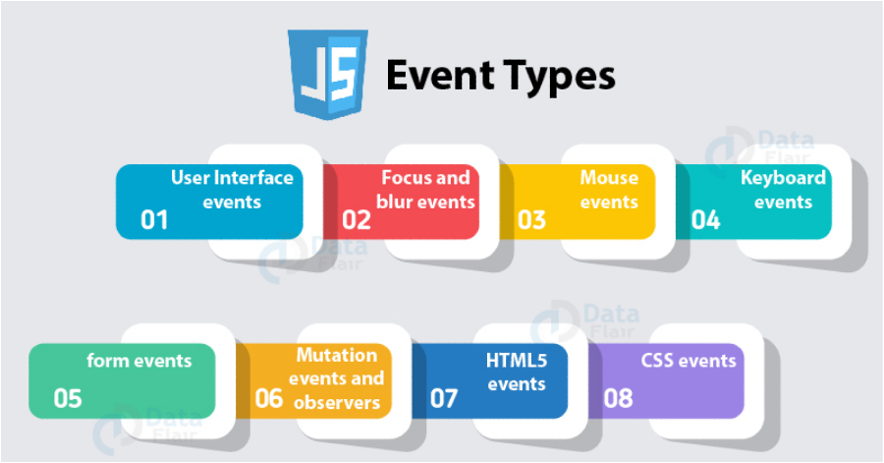
Type of Events

Slide 16

Type of Events
EvenListener
myElement.onclick = function(){ }
EvenHandler will always be
A function!

Slide 17
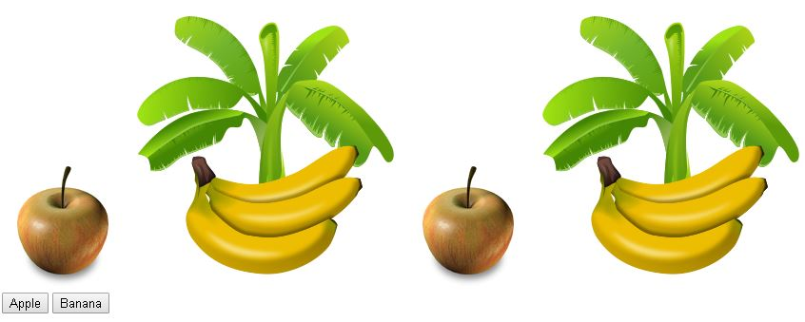
Today’s Assignment

